Slide 1

Sewer District
Audit
October 7, 2026
Phillip M. Amway
Assessment Department

Slide 2
Sewer District Audit – Discussion Topics
Issue identification
  Corrective Actions Completed (Issue Resolution)
  Results of Actions Completed
  Tax Implications
        Taxing Jurisdictions
        Individual Taxpayers
  Actions Remaining to Address Audit Findings

Slide 3
Sewer District Audit – Issue Identification
The Assessment Department performed a review of Town of Vienna Sewer Districts SW043 and SW072. The purpose of this review is to verify conformance with Local Law 4 of 2008.
Problem Statement
Most vacant land parcels within SW043 and SW072 are not assigned ½ of a sewer unit in conformance with Local Law 4 of 2008. Because of this condition, the cost burden of maintaining the sewer district is not being distributed equitably amount all property owners within the districts.

Slide 4
Sewer District Audit – Corrective Actions Completed
The Assessment Department performed the following actions to correct sewer unit assignments
    Performed sewer main end point verifications to bound districts
    Developed parcel lists for each sewer district
    Performed parcel by parcel review within the sewer district boundaries
    Confirmed conformance with Local Law 4 of 2008
    Determined non-conforming impacted parcel list for each district
    Consulted with Village of Sylvan Beach Clerk and Town Attorney regarding audit and planned actions

Slide 5
Sewer District Audit – Results of Actions Completed
Local Law 4 of 2008 Non-Conformances | Quantity
Assigned to Sewer District Units but not in District – SW043 | 1
P/C 220 (2 family) not assigned 2 units – SW043 | 1
P/C 300 series (Vacant Land) not assigned ½ Unit – SW043 | 44
P/C 220 (2 family) not assigned 2 units – SW072 | 3
P/C 230 (3 family) not assigned 3 units – SW072 | 3
P/C 300 series (Vacant Land) not assigned ½ Unit – SW072 | 32
Commercial Properties having too many/too few Units – SW072 | 3
Total items requiring corrective action – SW043 and SW072 | 87

Slide 6
Sewer District Audit – Sewer District Impacts
This table shows the impact of the corrected number of unit assignments by District and by Unit based on the 2027 budget.
The estimated impact on a vacant land parcel not having ½ sewer unit for SW043 is $715.11 / 2 = $357.56
The estimated impact on a vacant land parcel not having ½ sewer unit for SW072 is $437.54 / 2 = $218.77
District | Current Unit Count | 2027 Budget | Cost/Unit | New Unit Count | New Cost/Unit
SW043 | 121.50 | $101,903 | $838.71 | 142.50 | $715.11
SW072 | 250.34 | $117,847 | $470.75 | 269.34 | $437.54

Slide 7
Sewer District Audit – Remaining Actions
Correct the sewer unit assignments in RPS consistent with Local Law 4 of 2008
Notify vacant land owners within the Sewer Districts of the impending change and the estimated financial impact and when the impact will occur
The changes will be made on the 2027 assessment roll, the financial impacts will be realized on the 2028 property tax bills issued in January 2028.

Slide 8
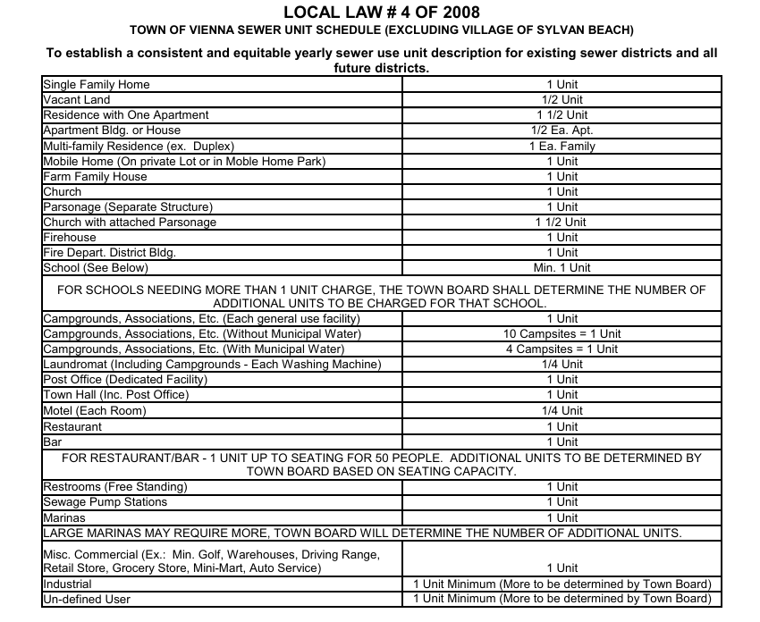

Slide 9
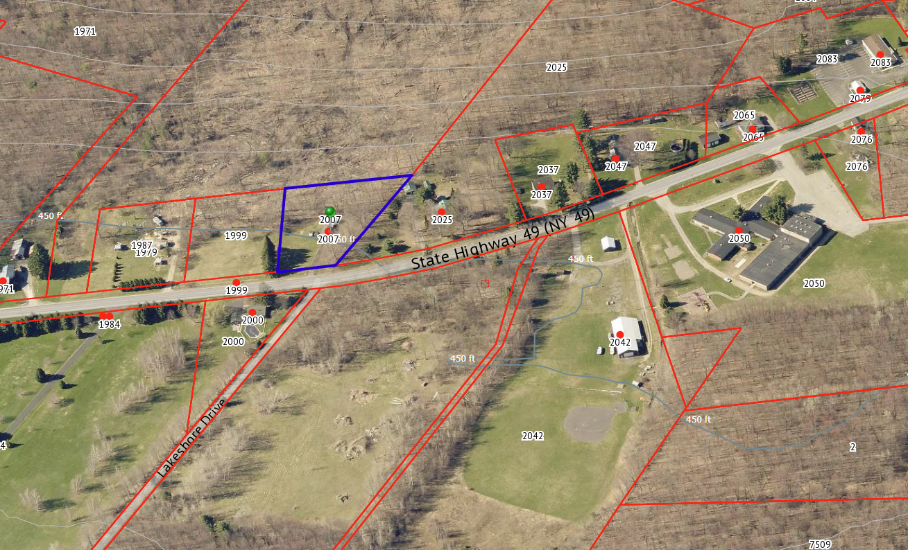
End of 2.5” Main
Sample of point to point verification of Sewer District boundary verification using Tax Maps, Sewer District Maps and Pictometry

